Slide 1



Iot Based women safety device
GPS Module implementation

Slide 2
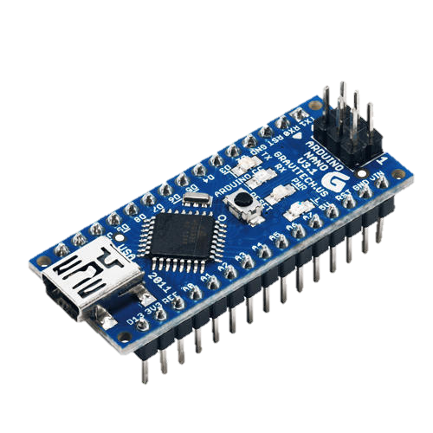
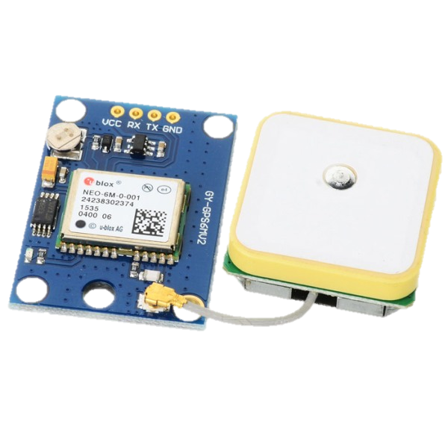
COMPONENTS USED
1) Arduino NANO :-
Arduino Nano is a microcontroller board designed by Arduino.cc. The microcontroller used in the Arduino Nano is Atmega328. It has 22 input/output pins in total, (14 Digital pins & 8 Analog pins). It has a crystal oscillator of 16MHz. It's operating voltage varies from 5V to 12V. It has an EEPROM memory of 1kb. It also has a mini USB Pin which is used to upload code.It also has a Reset button on it.
2) NEO-6M GPS Module:-
The NEO-6M GPS module is a well-performing complete GPS receiver with a built-in 25 x 25 x 4mm ceramic antenna, which provides a strong satellite search capability. With the power and signal indicators, you can monitor the status of the module
PIN-configuration :-
PIN Description
VCC Power Supply Input
GND Ground
TX Transmitted data
RX Received data

Slide 3
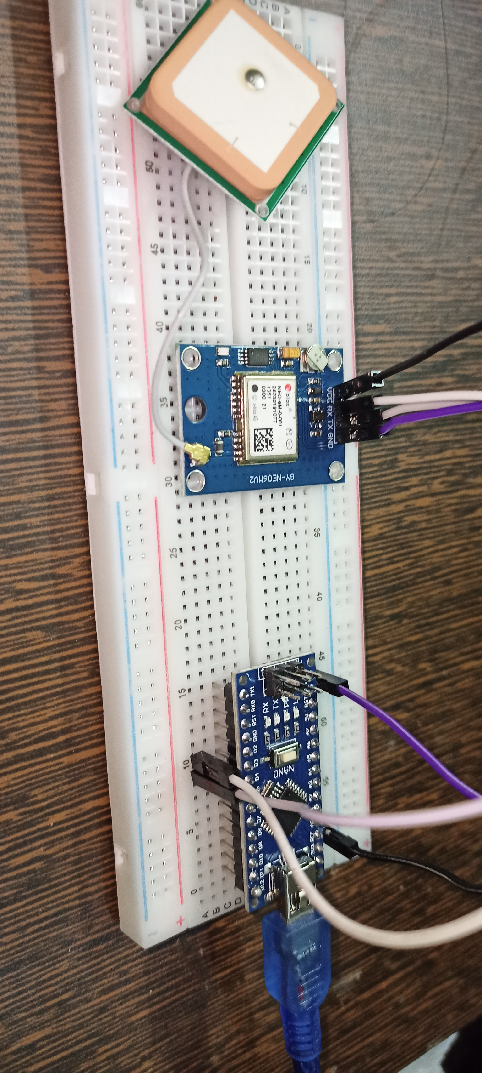
CIRCUIT CONNECTIONS

